Slide 1
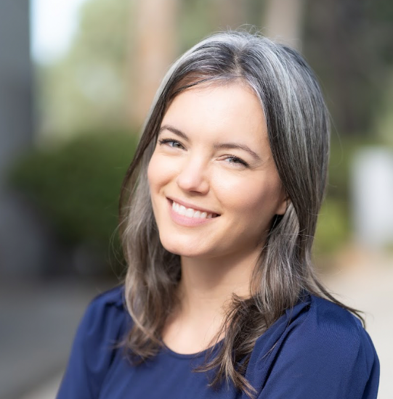
Purdue Institute for Integrative Neuroscience
and Psychological Sciences Department Presents
Wednesday, October 8, 2025
10:30 a.m. – 11:30 a.m., LILY, Room 1117
“Feeling the Force: PIEZO Ion Channels in Interoception”
Inside our bodies, various organs distend and contract as they perform their duties; nearby neurons monitor and transmit the resulting mechanical sensations to the brain to guide the appropriate behaviors. For example, stretch sensors in the stomach initiate digestion and tell us when we feel full, and bladder stretch alerts us to find a bathroom. Despite their importance, the mechanosensory systems that govern these processes are not well understood. We previously discovered that the mechanosensory ion channel PIEZO2 detects distension of the bladder and drives urinary reflexes. We are now identifying how PIEZO ion channels contribute to the physiology of the urinary tract in aging and inflammatory conditions as well as how the brain integrates mechanical cues from the body to mediate internal pain and emotion.
Dr. Marshall recently started her lab to study the role of Mechanosensation in Interoception with support as a McNair scholar and as a Freeman Hrabowski Scholar with the Howard Hughes Medical Institute. Dr. Marshalls’s Postdoc research contributed to her mentor’s Nobel Prize awarded in 2021 for discovery and study of Piezo 1 & 2 mechanosensor roles in interoception.
Refreshments provided
Faculty Hosts: Ed Fox (foxe@purdue.edu) and Chris Rochet (jrochet@purdue.edu).
Kara Marshall
Assistant Professor of Neuroscience
Baylor College of Medicine
Dr. Marshall’s website: https://www.themarshalllab.com/
Dr. Patapoutian’s Nobel lecture:
https://www.nobelprize.org/prizes/medicine/2021/patapoutian/facts/

